Slide 1

CITI BRIDGE PROGRAM 2022
BSE/NSE ARBITRAGE RECOMMENDATION SYSTEM
GROUP 7
Group Members:
Sanjyot Amritkar
Pranjal More
Vaishnavi Bhavsar
Brishti Basu
Kareena Ganshani

Slide 2
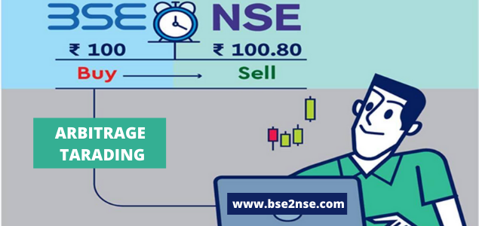
WHAT IS ARBITRAGE?
Buying a security in one market and selling it in another market at a higher price.
Two exchanges present in India
1. NSE(National Stock Exchange)
2. BSE(Bombay Stock Exchange

Slide 3
NEED OF ARBITRAGE RECOMMENDATION SYSTEM
It captures changes in the market quickly and accurately.
Occur only for short intervals

Slide 4

STRATEGY USED
Difference is calculated on the current prices of NSE and BSE.
Arbitrage=|NSEprice-BSEprice|

Slide 5
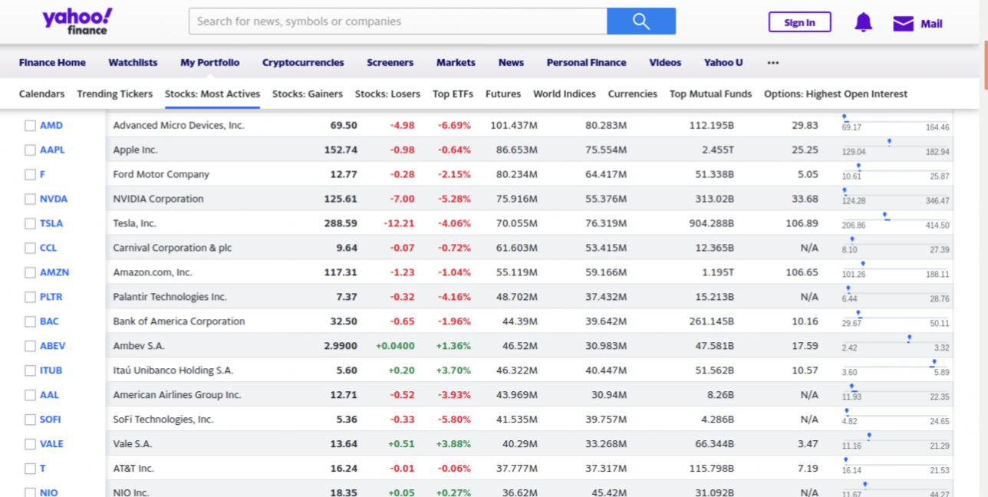
YAHOO FINANCE API
Yahoo Finance API is a RESTful API that provides access to financial data.
Range of libraries/API’s/methods →real time data.
Free to use,does not require an API key.

Slide 6
FUNCTIONALITY
User login: username + password authentication.
Arbitrage opportunity recommendations based on current prices
User can save from recommended stocks.
Saved stocks are prevailed in the user's account.

Slide 7
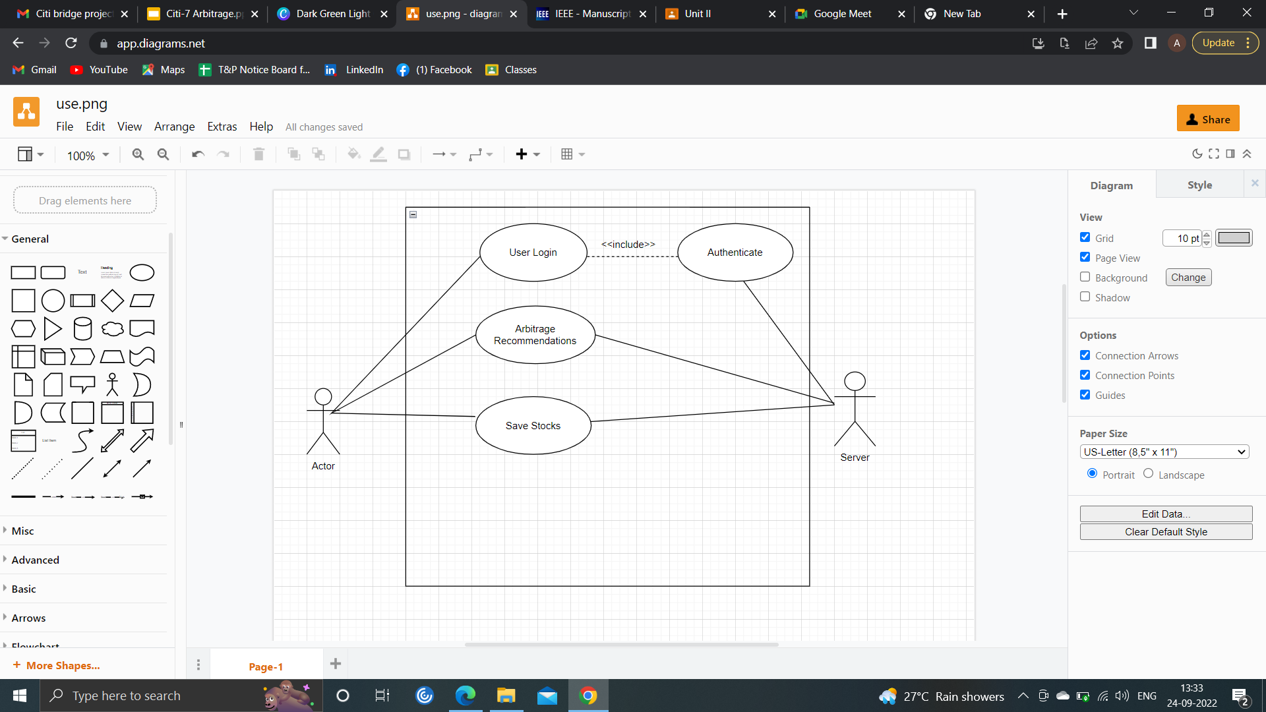
SYSTEM FLOW
LOGIN PAGE
ARBITRAGE RECOMMENDATIONS
SAVE
STOCKS
Successful Login
Unsuccessful Login
ALERT TO RE-RNTER CREDENTIALS

Slide 8

WIREFRAMING

Slide 9
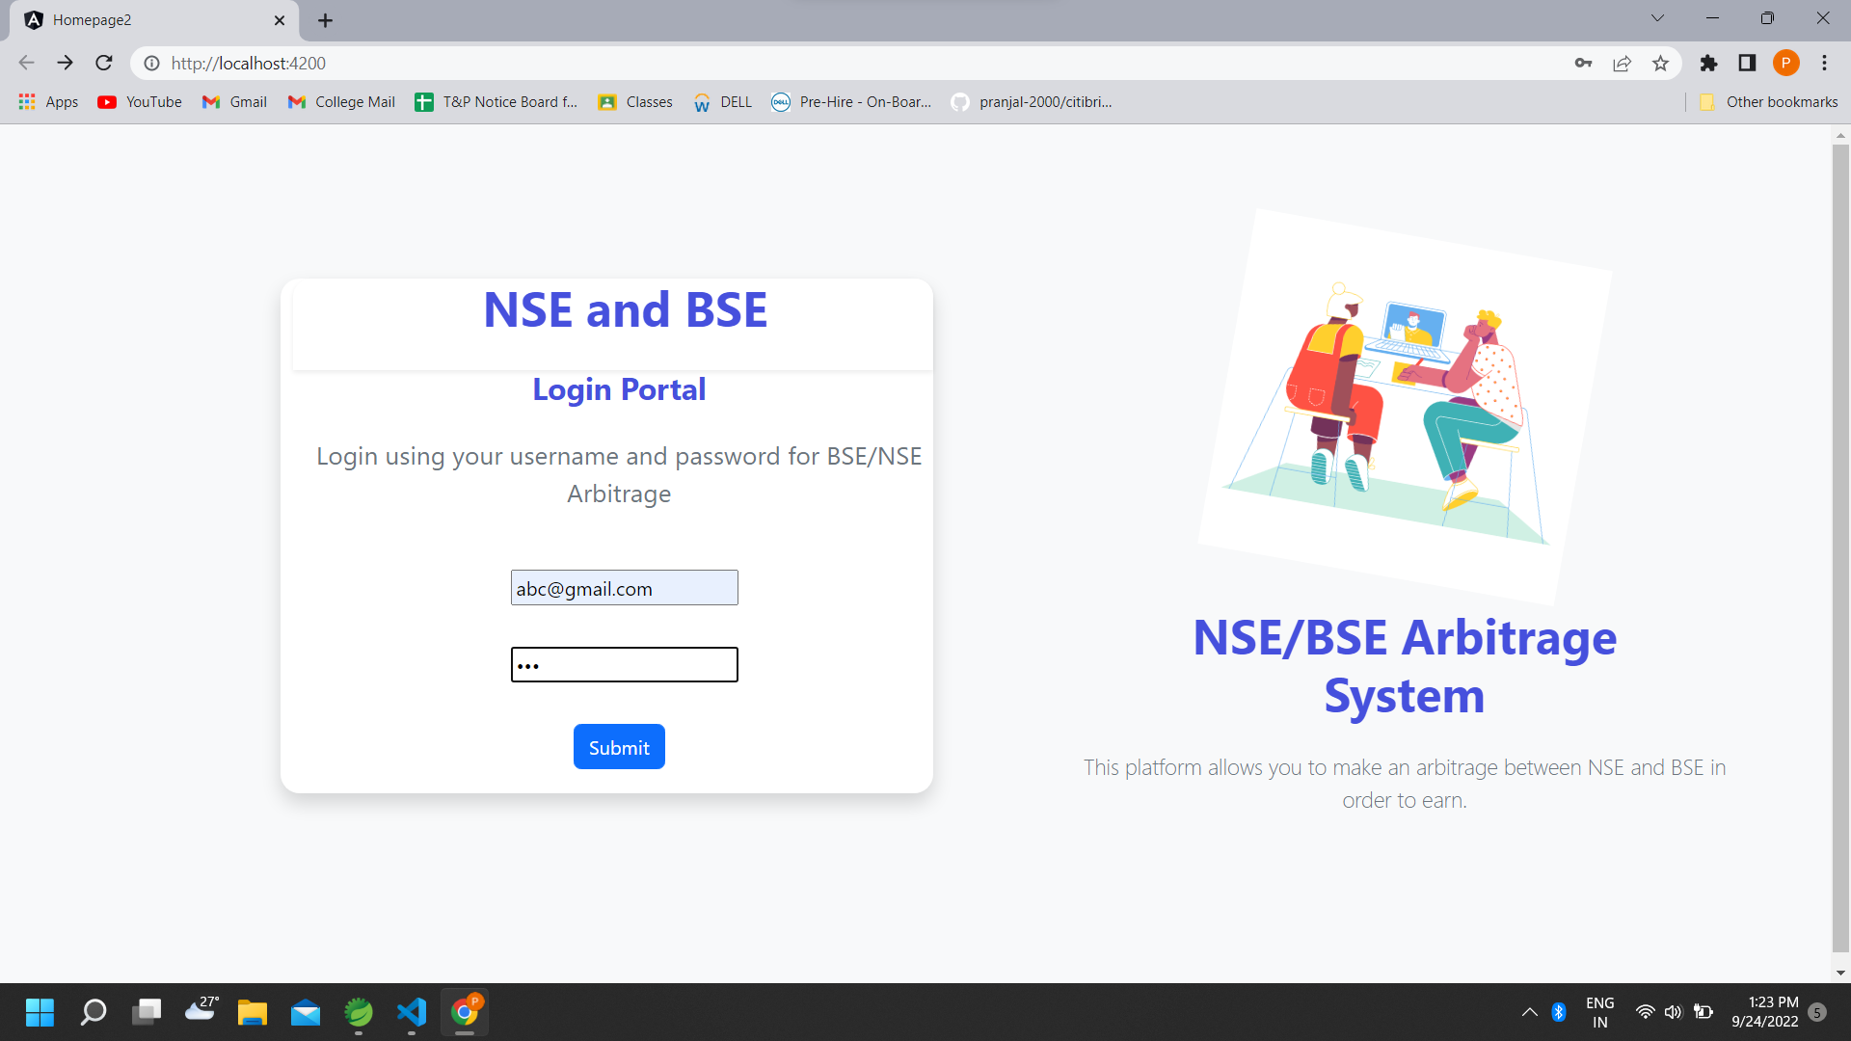
LOGIN PAGE
User login AUTHENTICATION by username and password.
Successful login- Recommendations
Unsuccessful login- Re enter the credentials

Slide 10
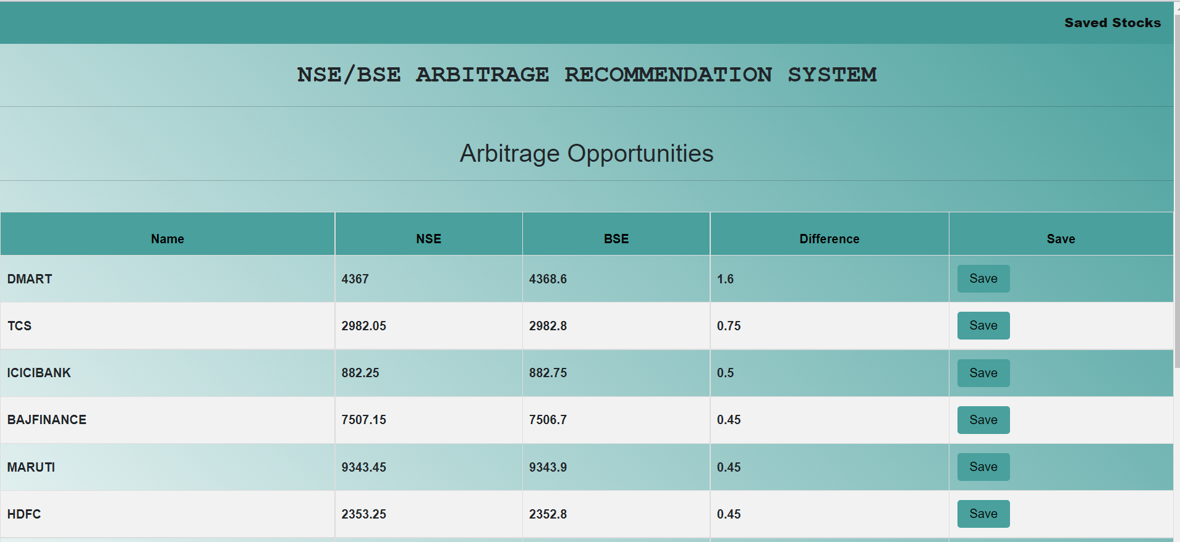
ARBITRAGE RECOMMENDATIONS(MAIN PAGE)

Slide 11
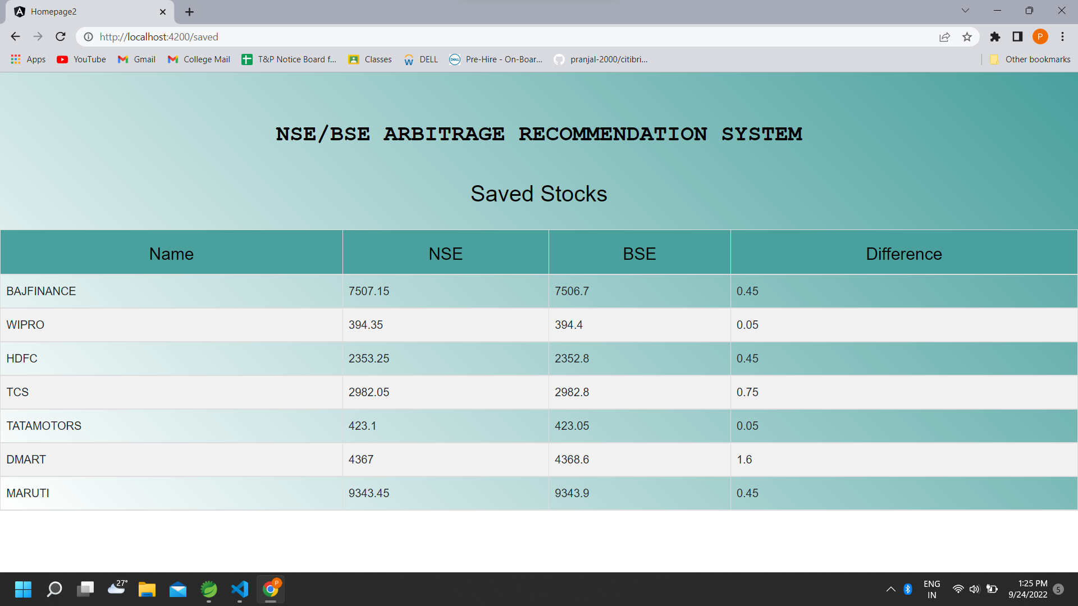
SAVED STOCKS

Slide 12



TECHNOLOGY STACK
Frontend : Angular
Backend : Spring boot
Database : MySQL

Slide 13
Adding a page to display all the stocks for different companies together
Enhancing compatibility for mobiles, desktop, tab browsers.
Adding a delete stock functionality for user
Graphical representation in historical analysis.
FUTURE SCOPE

Slide 14

LEARNINGS
TECHNICAL
NON-TECHNICAL
Tech Stacks
Problem Solving Skills
Arbitrage,
NSE/BSE
Teamwork
Yahoo Finance
API
Communication
Skills
Deadlines,Scrum meetings

Slide 15
THANK YOU !

